Slide 1
Sprint 2 Review

Slide 2
Agenda
Product Backlog
Sprint Backlog
TaskBoard
Sprint Burndown Chart
Lessons Learned
Demo

Slide 3

Product Backlog

Slide 4
Sprint Backlog
Reqt | Requirement Description | Priority | Effort
A01.2 | The game shall support one human player and three simulated players. | 1 | 25
A03.2 | The game shall display the current game score of the four players at all times. | 4 | 8
A03.1 | The game shall display the number of tricks taken by each player in the current hand along with the remaining number of tricks in the hand. | 5 | 5
A03.3 | The game shall make the cards from each player clearly visible on each trick until the human player indicates to play the next trick. | 6 | 13
A03.4 | The human player’s hand shall be sorted by suit and then left to right from highest to lowest( i.e A,K ..2) |  | 3
A05.1 | For the first release, the game shall be played on a browser. | 7 | 3
B01 | The player to the left of the dealer bids first, with bids proceeding clockwise. | 10 | 3
B02 | Players may bid to take any number of tricks from 0(nil) to 13 at the beginning of the hand | 11 | 3
B03 | A player may bid nil (to take 0 tricks). All bids of 0 are nil bids. | 12 | 3
B02.1 | A bidding strategy that may be used by a simulated player is to bid the number of spades held | 13 | 5

Slide 5
Reqt | Requirement Description | Priority | Effort
P01 | The player to the left of the dealer shall make the opening lead. | 20 | 8
P02 | The player winning a trick shall make the lead for the next trick. | 21 | 13
P02.2 | A lead strategy is to lead 1) a suit where you do not have the A, K, or Q; 2) an ace; 3) underlead a queen; 4) underlead a king. | 22 | 20
P02.1 | Spades may not be led until there is a ruff (aka trump, cut). | 23 | 10
P03 | Each player will follow suit if they can do so. | 24 | 8
P03.1 | If all players follow suit or sluff (play a non-spade without following suit), the highest card in the suit led wins the trick (in order, AKQJ…2). | 25 | 5
P03.2 | If a player cannot follow suit, they may ruf the trick. | 26 | 20
P03.3 | If a player ruffs a trick, the highest spade played takes the trick (i.e., another player can over-ruff). | 27 | 5
P04.1 | A playing strategy when another player bids nil is to ignore the nil bidder. | 28 | 3

Slide 6
Reqt | Requirement Description | Priority | Effort
S01 | Players that take the number of tricks bid for the hand score bid X 10 points. | 30 | 8
S02 | A player that takes fewer than the number of tricks bid on a hand (for non-nil bid), scores the bid X -10 points. | 31 | 8
S03 | A player that takes overtricks on a hand loses 10 points per overtrick from their bid X 10 points. | 32 | 8
S04 | A player that takes no tricks for the hand where they bid nil scores 100 points. | 33 | 8
S04.1 | A player that takes a trick after bidding nil scores -100 points. | 34 | 8
TOTAL |  |  | 203

Slide 7
Goal Of the Sprint 2
Sort the human player’s hand.
The players will be able to bid from 0 to 13 tricks.
Bidding Strategy: Number of spades+ Number of high ranked cards.
Decide a strategy for a simulated player to pick a card.
We wanted the simulated player to play a card and build up on that to make them play a trick and then an entire round.
Decide the winner for a trick and update the scores.
Display the score board at the end of the round.

Slide 8
Splitting of Stories
Reqt | Requirement Description
A01.2.1 | A Human Player shall be able to play
A01.2.2 | Simulated player shall be able to play
A03.3.1 | The simulated player must pick a card to play
A03.3.2 | Display the simulated player’s selected card in the GUI

Slide 9
Tech Stories
We removed the server side dependencies because till the end of the last sprint, we were working in ASP. Net
In this sprint we moved to JavaScript.
“ We do not solve the problems, that we don’t know we may have in the future”

Slide 10
Taskboard
Task | User story | Checked out story | Not Checked out story | Status
Decide the bidding strategy |  | Checked |  | Done
Display the bid window |  | Checked |  | Done
Show the every player’s bids |  | Checked |  | Done
Strategy to pick a card and play it-for simulated players |  | Checked |  | Done
Sorting the cards in a ranked order |  | Checked |  | Done
Decide the winner for the round |  | Checked |  | Done
Show the score board at the end of each round |  | Checked |  | Done

Slide 11
Task | User story | Checked out story | Not Checked out story | Status
Allow a player to make a null bid |  | Checked |  | Done
Decide the over, under and successful bids |  | Checked |  | Done
Do not allow playing before bidding is done |  | Checked |  | Done
Reset the game at any point of time |  | Checked |  | Done
Play another game after one round |  | Checked |  | Done
If player does not have the leading suit, then he can play spades or any other suit |  | Checked |  | Done
If player is out of spades, they should play a card of any other suit |  | Checked |  | Done

Slide 12
Task | User story | Checked out story | Not Checked out story | Status
Update GUI with selected cards by every player in the play area |  | Checked |  | Not Done
Follow a clockwise order in the game |  |  | Not Checked | Not Done
Winner of the trick should lead next trick |  |  | Not Checked | Not Done
Player should not be able to play spades until it is ruff |  |  | Not Checked | Not Done
Player to the left of the dealer should lead the trick |  |  | Not Checked | Not Done

Slide 13
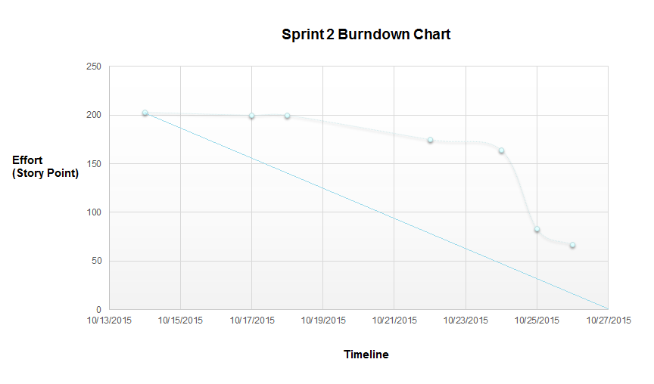
Sprint Burndown Chart

Slide 14
Lessons Learned
Pair Programming:
We found it to be very useful because there are many times when one person is out of ideas and having another person sitting next to the coder, helps us get fresh ideas on solving the problem or proceeding in a different direction.
It makes our progress slow because 2 resources are engaged in the same task. But this also proved to be very effective because of which we were able to achieve most of the goals in the sprint.
It is very ineffective when you know exactly what is to be done. This is a waste of resources.

Slide 15
Walking Skeleton
We learned that walking skeleton is important because it helped us develop a minimal implementation of a functionality on which we could build up in the next few meetings. This helped us gain confidence that the architectural design we had decided, was correct and we are moving in the right direction.
It saves lot of time. Walking skeleton means implementing a small functionality. Therefore, if we fail, we can immediately back track and start thinking about some other solutions.
We have observed that building a component for a player 1 to play the card is also applicable to the rest of the players and bidding is same too.
Therefore one of the components for one player is applicable to others too.

Slide 16
We overestimated the effort needed to complete some stories
We underestimated our capabilities to finish the user stories for the sprint.

